Slide 1

INTERNET OF THINGS
Chapter5: IP as the IoT Network Layer
Dr. Nagegowda K S
Department of Computer Science & Engineering

Slide 2
INTERNET OF THINGS
Agenda
The Business Case for IP
The Need for Optimization
Optimizing IP for IoT
Profiles and Compliances

Slide 3
INTERNET OF THINGS
Optimizing IP for IoT- RPL
Routing Protocol for Low Power and Lossy Networks(RPL):
Storing node
Non-storing node

Slide 4
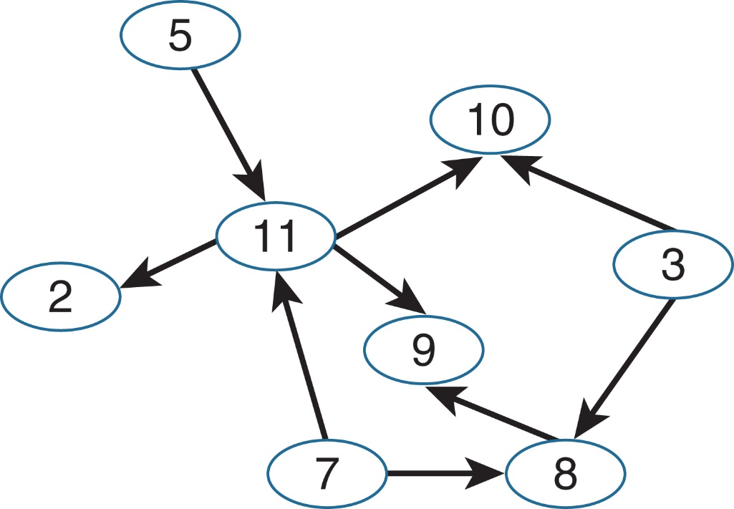
INTERNET OF THINGS
Optimizing IP for IoT- RPL
Figure - Example of a Directed Acyclic Graph (DAG)

Slide 5
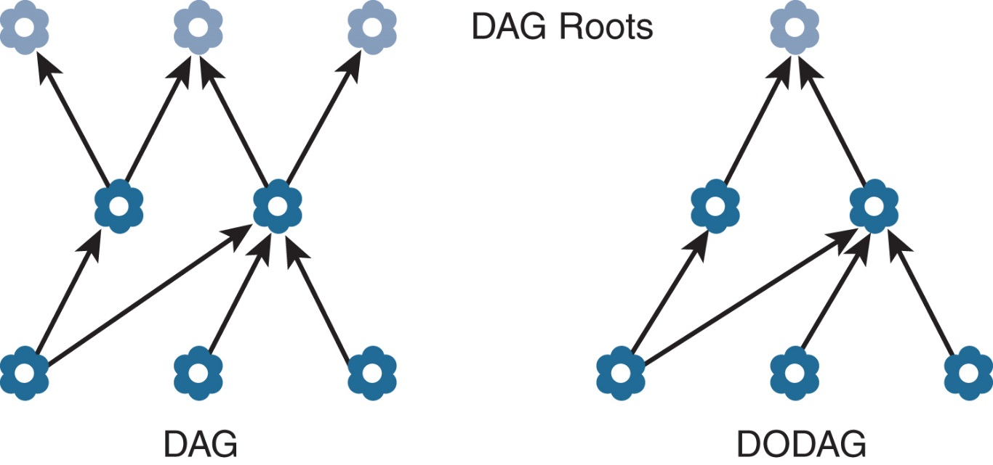
INTERNET OF THINGS
Optimizing IP for IoT- RPL
Figure - DAG and DODAG Comparison

Slide 6
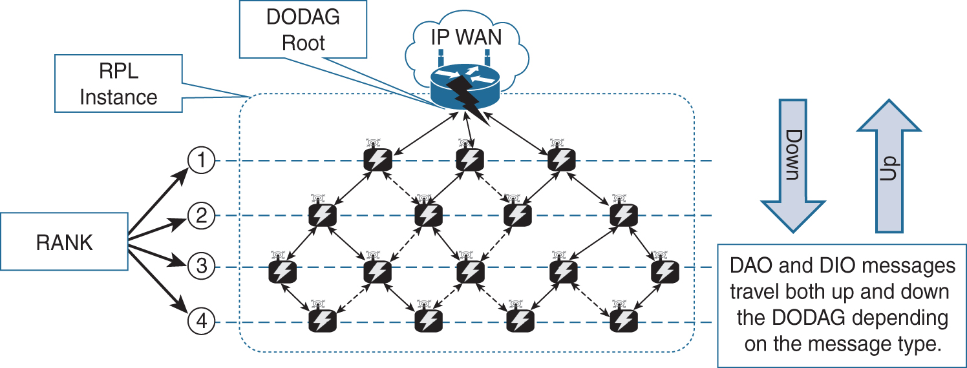
INTERNET OF THINGS
Optimizing IP for IoT- RPL
Figure - RPL Overview

Slide 7
INTERNET OF THINGS
Optimizing IP for IoT- RPL Metric
Metrics:
Expected Transmission Count
Hop Count
Latency
Link Quality Level
Link Color
Node State and Attribute
Node Energy
Throughput

Slide 8
INTERNET OF THINGS
Authentication and Encryption on Constrained Noded
ACE
DICE

Slide 9
INTERNET OF THINGS
Profiles and Compliances
Internet Protocol for Smart Objects Allinance
Wi-SUN Alliance
Thread

Slide 10

THANK YOU
Dr. Nagegowda K S
Department of Computer Science & Engineering
nagegowda@pes.edu

